Slide 1




Slide 2
A secret key crypto system
INDIA SOFTWARE LABS
Lakshmanan Velusamy
India Software Labs
ISL TechConnect 2011

Slide 3
Clip-arts
Courtesy
  www.barrysclipart.com
  www.livinggraphics.com

Slide 4
Warm up !!
What is the motivation ?
What is a public key and private / secret key algorithm ?
Algorithm
Working Example
Mathematical Properties Used
How did work ? - Proof

Slide 5
MOTIVATION
There is always a need for a secret key encryption algorithm which would be
  hard to break (Breaking shouldn't happen in polynomial time)
  Lesser computing power Consuming.
  It would be good if an encryption algorithm could reduce the amount of data to be transferred.

Slide 6
WHAT IS A PUBLIC KEY CRYPTO SYSTEM ?
Are asymmetric key algorithms
The key used to encrypt a message is not the same as the key used to decrypt it.
Contains a secret private key and a published public key.
Messages are encrypted with the recipient's public key and can only be decrypted with the corresponding private key.
The keys are related mathematically, but the private key cannot feasibly (ie. in actual or projected practice) be derived from the public key.
Example : RSA, Paillier cryptosystem, Cramer–Shoup cryptosystem

Slide 7
WHAT IS A SECRET KEY CRYPTO SYSTEM ?
Also called as secret key crypto system / Symmetric key Crypto system.
Uses one key, the secret key, that is used to both encrypt and decrypt messages.
The term "private key" is often used inappropriately to refer to the secret key.
Requires a secure initial exchange of one or more secret keys between both sender and receiver.
Example : Caesar Cipher, DES, AES etc

Slide 8


Algorithm
Decides P
Decides Q
exchange
P
Q
ALICE
BOB

Slide 9
Algorithm
Message (M), i
Sends
Receives
E, i
Computes
E = ( M * Pi ) % (PQ – 1)
ALICE
BOB

Slide 10
Algorithm
Decrypts Message (M)
ALICE
Computes
M = ( E * Q^{i} ) % (PQ–1)
BOB

Slide 11
Example
Decides 5
Decides 50024
exchange
P
Q
ALICE
BOB

Slide 12
Example
Message (2001), 3
Sends
Receives
6, 3
Computes
( 2001* 5³ ) % 250119 = 6
ALICE
BOB

Slide 13
Example
Decrypts Message (2001)
ALICE
Computes
(6 * 50024^{3) %} 250119 = 2001
BOB

Slide 14
Mathematical properties
The following rules of modular arithmetic are used.
  A % (A – 1) = 1
  (A * B) % N = ((A % N) * (B % N)) % N
  (A % N) % N = A % N

Slide 15
Proof – How the Message is retrieved?
Bob receives < E, i > and does the following.
( E * Q^i ) % (PQ – 1)
Lets say N = (PQ – 1)
So,
( E * Q^i ) % N
E = ( M * P^i ) % (PQ – 1) = ( M * P^i ) % N
= ( ( ( M * P^i ) % N) * Q^i ) % N
= (M * P^i * Q^i ) % N
= (M * PQ * PQ * PQ .... i times ) % N
= ((M % N) * (PQ % N) * (PQ % N) * (PQ % N).... i times ) % N
as per the rule (A * B) % N = ((A % N) * (B % N)) % N
= ((M % N) * 1 * 1 * 1 ... i times ) % N
Since PQ % N = PQ % (PQ – 1) and A % (A – 1) = 1
= (M % N) % N
= M % N
Hence the message will be retrieved till the message is < N. Which implies the N i.e., P & Q has to be large enough to hold good for any large message ( as we choose P & Q for RSA ).
And as said, i can be any random number. So, even if the same message needs to be transferred by varying i, the same message can be encrypted to different number each time.

Slide 16
Proof – How one to one mapping is assured?
gcd ( P power i ,PQ -1 ) = 1 for any value of P,Q and i
gcd ( Q power i ,PQ -1 ) = 1 for any value of P,Q and i

Slide 17
Proof – Will encryption result in zero?
Assume p>=3
p % p -1 will not be equal to 0 ==== A ( trivial property )
=> p - 1 will not have any factors of p
Our encryption/ decryption is of the form
(m* p power y) % np - 1
To prove:
(m* p power y) % np - 1 is not 0
P % np - 1 is not 0 ==> 1
np - 1 will not have factors of np as its factor. ==> 2 ( from 1)
So factors of n and factors of P will not be the factors of np -1 ==> 3
Which => p % np -1 not equal to 0 ==> Conclusion 1
or p power y mod np - 1 not equal to 0 == > Conclusion 2
where n and y are any numbers..
or (m* p power y) % np - 1 is not 0
when m < np -1 and p,n,y are any numbers.
This implies there is non residual weakness or encryption will not lead to zero.

Slide 18
How message compression is achieved ?
As per the above stated encryption method, modulo arithmetic is effectively used without loosing the data precision.
The encrypted data is sent as a tuple < E, i >. So the amount of data transferred to transfer m is length of ( E ) + length of ( i ).
SE = length of ( E ) + length of ( i )
SM = length of ( M )
SM --> length of actual message
SE --> length of transferred message
Hence the amount of data transferred can be reduced, by choosing optimal ‘i’ value by keeping a good trade off between the amount of computation involved and the amount of data to be sent. This is clearly a potential Operational Research problem.

Slide 19
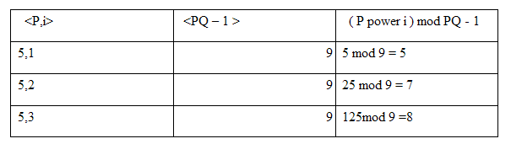
Example : Sample pre-computed table

Slide 20
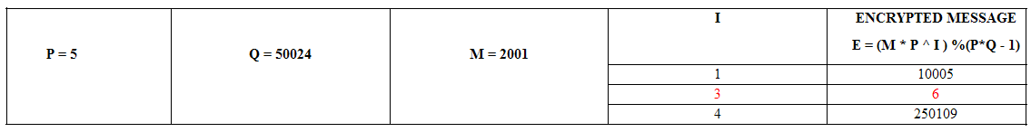
Example : Message compression

Slide 21

Questions!!

Slide 22
THANKS !

